Slide 1
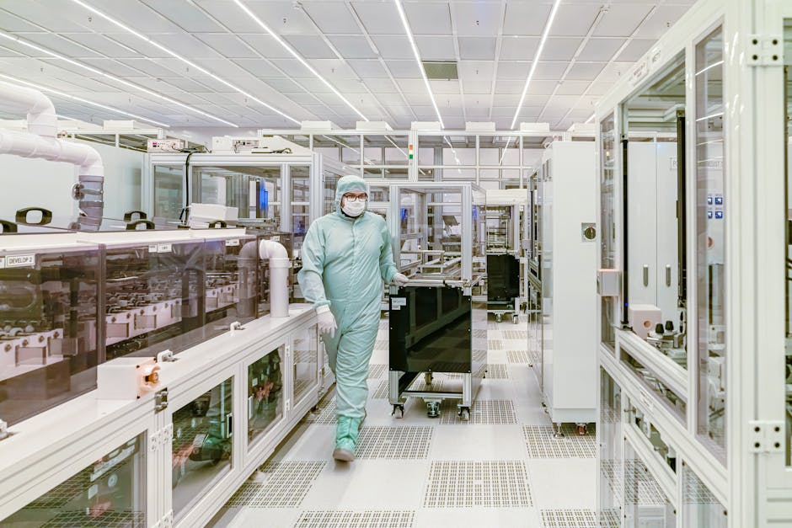
Project QuantumForge
Defense & Space Electronics | Investment Teaser
BUSINESS PROFILE
• Tier-1 Strategic Partner to ISRO, DRDO, and Global Defense Primes (Thales, Rafael).
• 3 State-of-the-art Manufacturing Units (AS9100D Certified) in Bangalore & Hyderabad.
• Diversified Revenue Mix: 45% Exports (USA/EU) | 55% Domestic Strategic Projects.
KEY PORTFOLIO MIX
Missile Control Electronics
Satellite Payloads (Space-Grade)
Radar & EW Systems
Aero-Structure Assemblies
Strictly Private & Confidential – Prepared by Kelp M&A Team

